Slide 1

NOVA LTD PEN TESTING CASE STUDY

Slide 2
Executive Summary
Nova Ltd – Penetration testing
Nova Ltd is an Online e-commerce corporation specializing in retail services in the United States, It is a growing technology firm with about 35 employees which builds web applications for clients and maintains development and testing servers inside their its office network. These systems are used daily by the engineering, operations, and finance teams.
Key Objectives of the Investigation:
Identify security vulnerabilities in the assigned test machine.
Assess the risk of unauthorized access.
Provide mitigation strategies to enhance security
Penetration testing Involvement: The penetration testing team played a critical role in identifying and contextualizing the
Website and internal system vulnerabilities. By leveraging log analysis and penetration testing tools, the team was able to uncover vulnerabilities and potential threats consistent with insecure open ports while assessing the risk level of the involved IP address. Our recommendations shall ensure that there is an effective mitigation strategy, reinforcing Nova Ltds’ security posture as the company continues its growth trajectory.

Slide 3
Assessment Overview
From September 15th to 22nd 2025, Nova Ltd engaged Alfa Tech IS Audit team to evaluate the security posture of its infrastructure compared to current industry best practices that included an internal network penetration test. All testing performed is based on the NIST SP 800-115 Technical Guide to Information Security Testing and Assessment, OWASP Testing Guide (v4), and customized testing frameworks.
Phases of penetration testing activities include the following:
Phase 1: Network Reconnaissance: Step 1: Port Scan;
Phase 2: Vulnerability Scanning: Identified potential vulnerabilities on discovered services by using Nmap NSE scripts, i.e. nmap --script vuln 192.168.40.4
Phase 3: Exploitation: Exploit 4 known vulnerabilities and gain shells, Project Workflow Common Metasploitable 2 Exploits:
Phase 4: Post Exploitation: Gathering basic system info and prove system access.
Phase 5: Technical report: Testing Summary, Recommendations and Conclusion

Slide 4
Scope
Target Machine: One internally hosted system (Metasploitable VM).
Testing Approach: Grey-box penetration testing (IP address provided).
Allowed Testing Methods: Network scanning, vulnerability exploitation, post-exploitation analysis
IP ADDRESS: 192.168.40.4

Slide 5
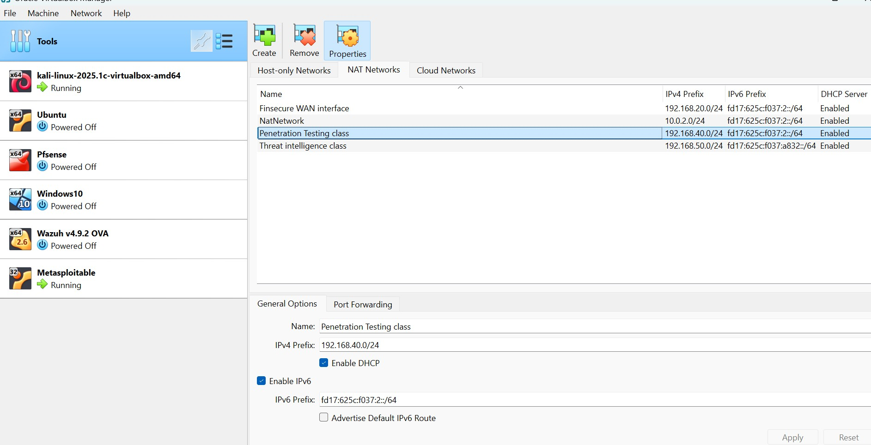
Setting up the NAT network

Slide 6
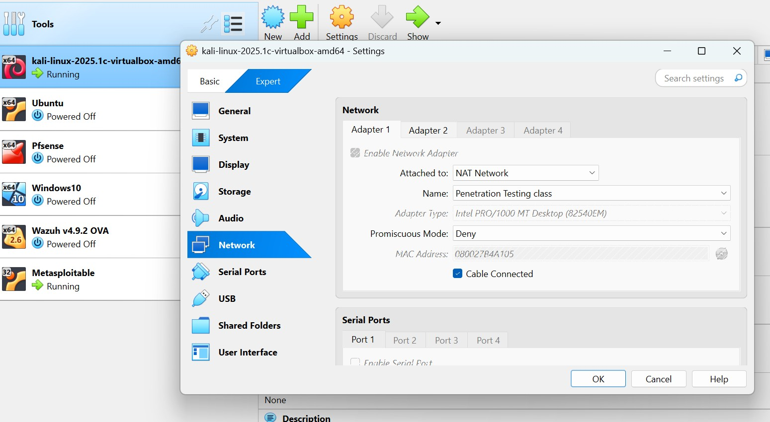
Kali Network configuration

Slide 7
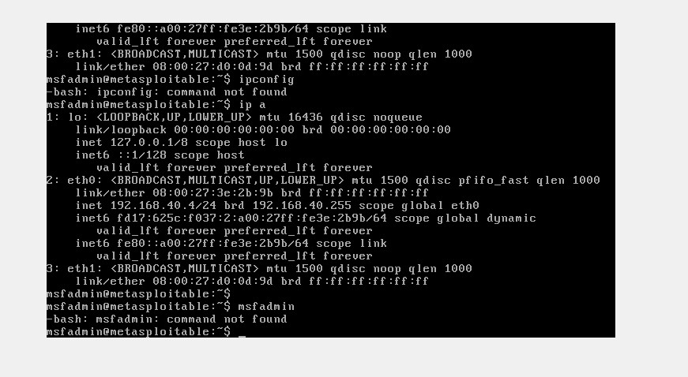
Showing metasploitable IP address 192.168.40.4

Slide 8
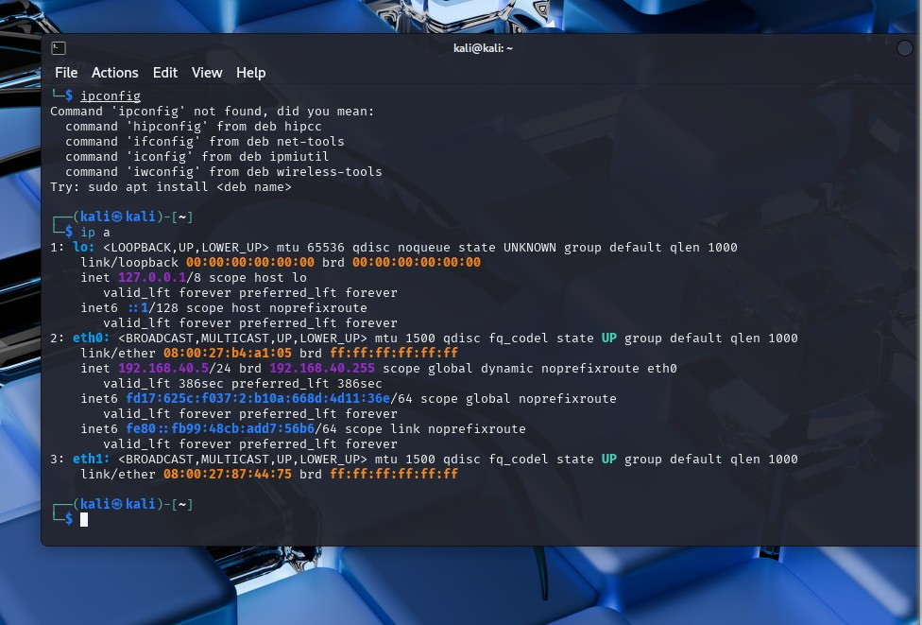
Pinging Metasploitable IP address on Kali using command IP a

Slide 9
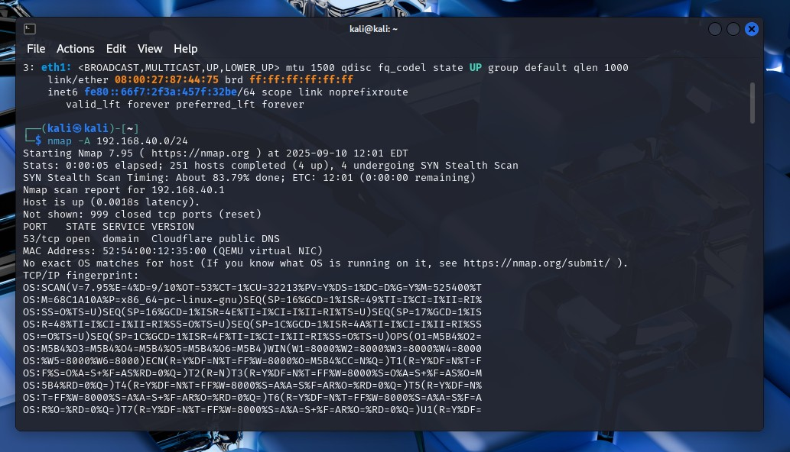
Phase 1: Network Reconnaissance: Step 1: Port Scan; First, in order to check which ports are open on the machine, run nmap scan to search for open ports

Slide 10
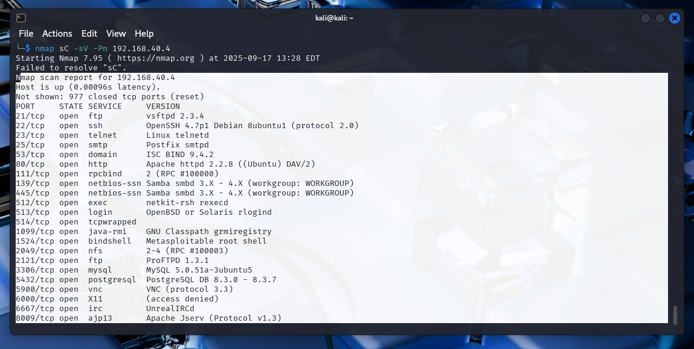
I ran this command: nmap -sC -sV –Pn 192.168.40.4 to generate scan report

Slide 11
Table of numerous open ports are discovered
TCP PORT | OPEN | VERSION
21 | ftp | vsftpd 2.3.4
22 | ssh | SSH 4.7p1 Debian 8ubuntu1 (protocol 2.0)
23 | telnet | Linux telnetd
25 | smtp | Postfix smtpd
53 | domain | ISC BIND 9.4.2
80 | http | Apache httpd 2.2.8 ((Ubuntu) DAV/2)
111 | rpcbind | 2 (RPC #100000)
139 | netbios-ssn | Samba smbd 3.X - 4.X (workgroup: WORKGROUP)
445 | netbios-ssn | Samba smbd 3.X - 4.X (workgroup: WORKGROUP)
512 | exec | netkit-rsh rexecd
513 | login | BSD or Solaris rlogind
1099 | java-rmi | GNU Classpath grmiregistry
1524 | bindshell | Metasploitable root shell
2049 | nfs | 2-4 (RPC #100003)
2121 | ftp | ProFTPD 1.3.1
3306 | mysql | MySQL 5.0.51a-3ubuntu5
5432 | postgresql | PostgreSQL DB 8.3.0 - 8.3.7
5900 | vnc | VNC (protocol 3.3)
6000 | X11 | (access denied)
6667 | irc | UnrealIRCd
8009 | ajp13 | Apache Jserv (Protocol v1.3)
8180 | http | Apache Tomcat/Coyote JSP engine 1.1

Slide 12
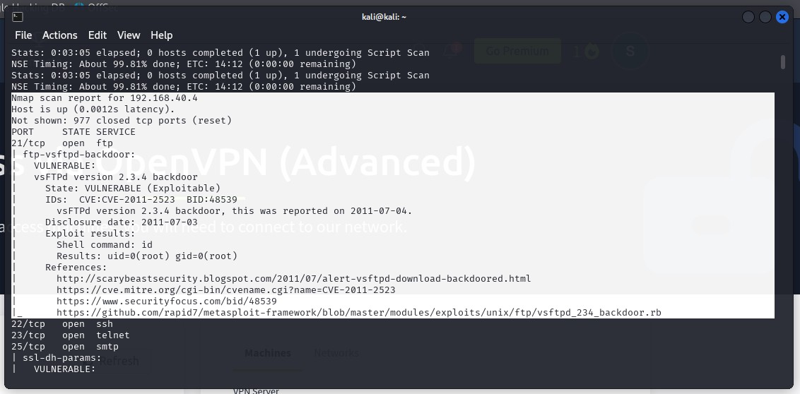
Phase 2: Vulnerability Scanning: Identified potential vulnerabilities on port 21 by using Nmap NSE scripts, i.e. nmap --script vuln 192.168.40.4

Slide 13
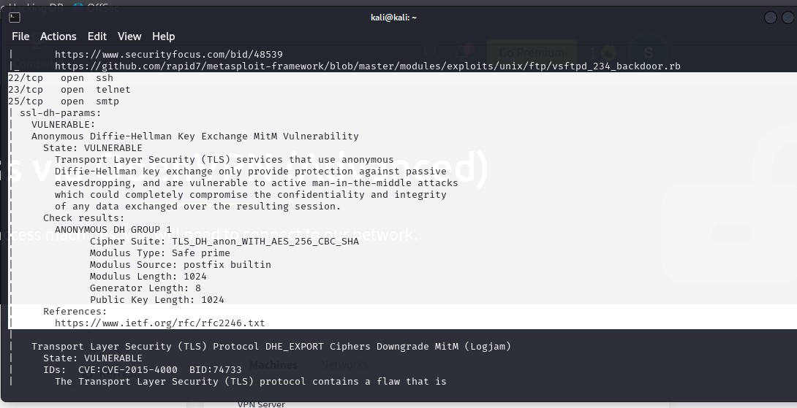
Scan showing vulnerability on port 22, 23 and 25

Slide 14
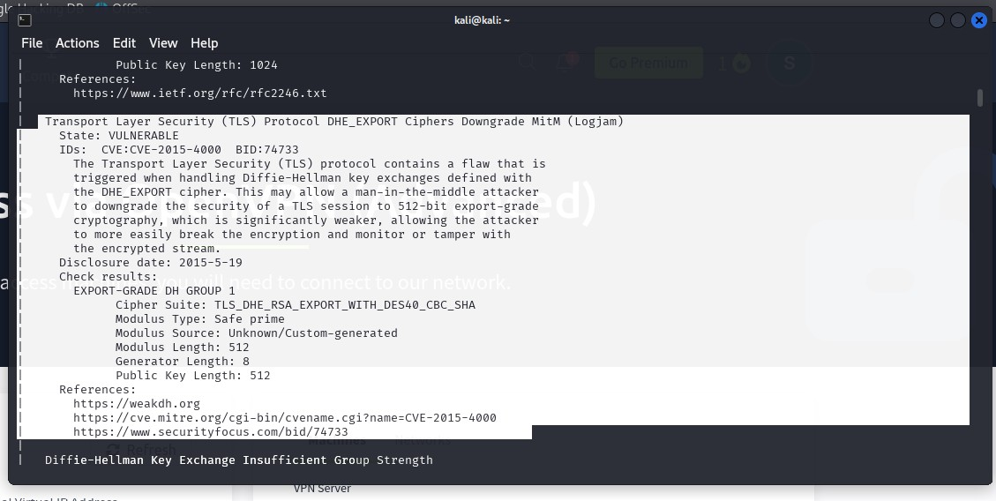
Vulnerability on TLS protocol

Slide 15
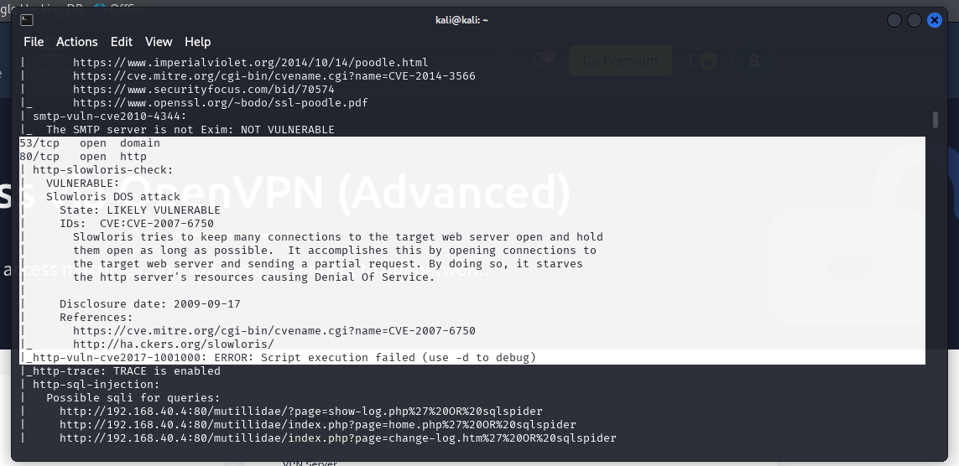
Vulnerability analysis on DNS: 53 and HTTP: 80

Slide 16
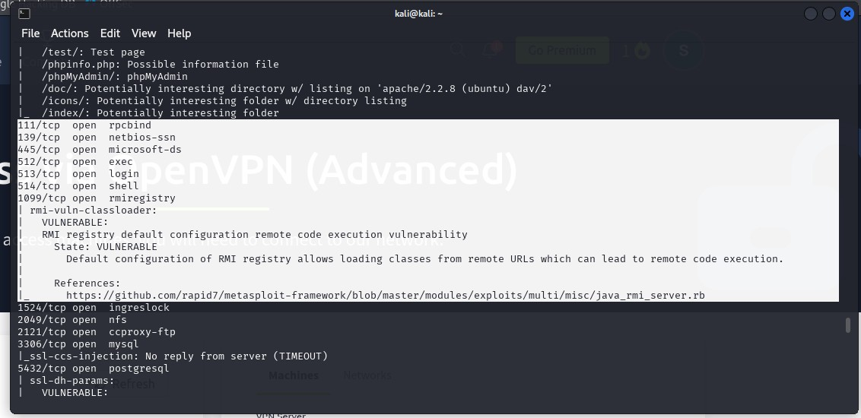
Vulnerability analysis on port 139

Slide 17
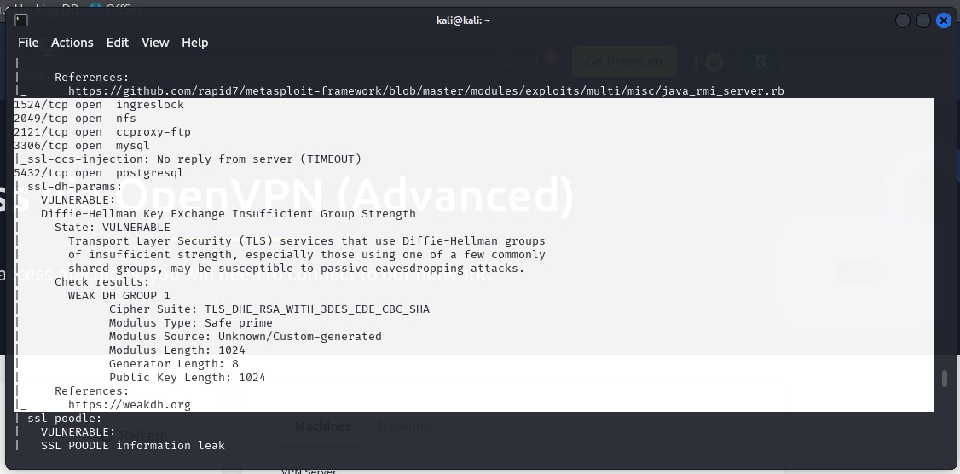
Vulnerability analysis on port 3306

Slide 18
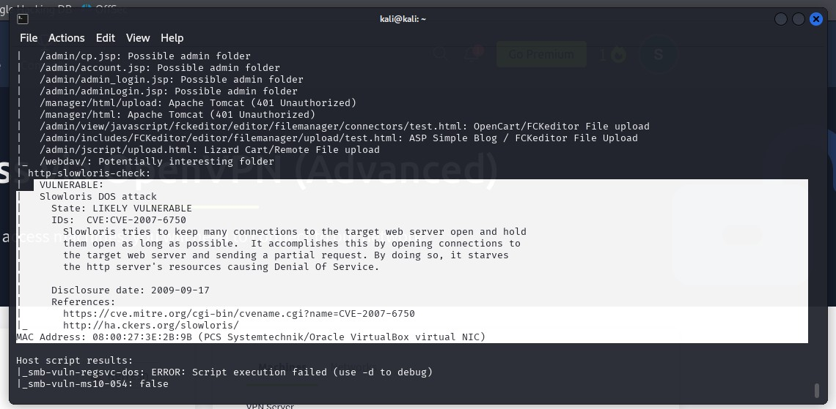
Vulnerability analysis on port 8180

Slide 19
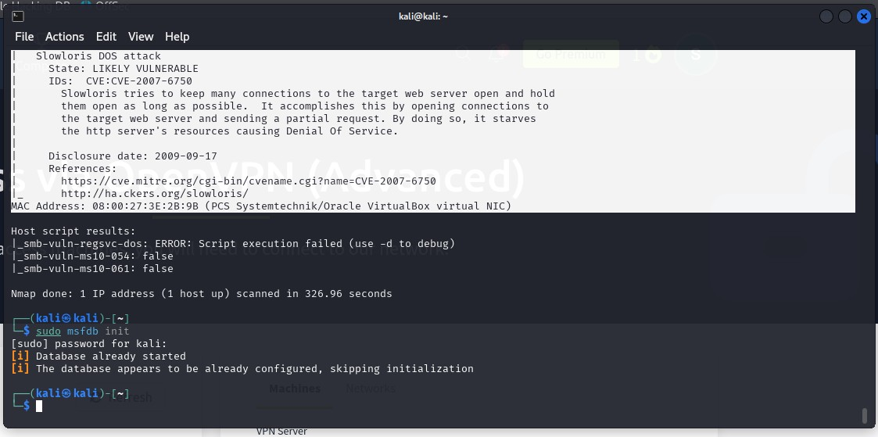
Running command to save activity

Slide 20
Phase 3: Exploitation: Exploit 4 known vulnerabilities and gain shells, Project Workflow Common Metasploitable 2 Exploits:
PORT | OPEN | VERSION | EXAMPLE EXPLOIT MODULE
21 | ftp | vsftpd 2.3.4 | exploit/unix/ftp/vsftpd_234_backdoor
80 | http | Apache httpd 2.2.8 ((Ubuntu) DAV/2) | scanner/http/dir_scanner
139 | netbios-ssn | Samba smbd 3.X - 4.X (workgroup: WORKGROUP) | exploit/multi/samba/usermap_script
3306 | Mysql | MySQL 5.0.51a-3ubuntu5 | auxiliary/admin/mysql/mysql_sql (for weak creds)
8180 | http | Apache Tomcat/Coyote JSP engine 1.1 | exploit/multi/http/tomcat_mgr_upload

Slide 21
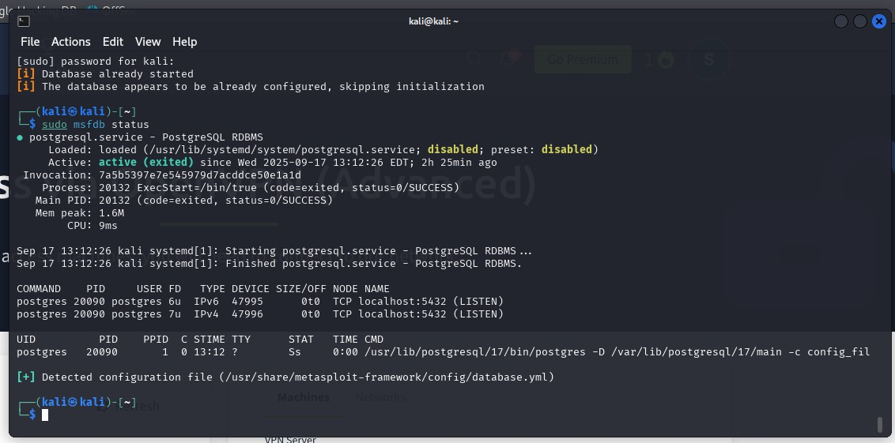
Running command to check status

Slide 22
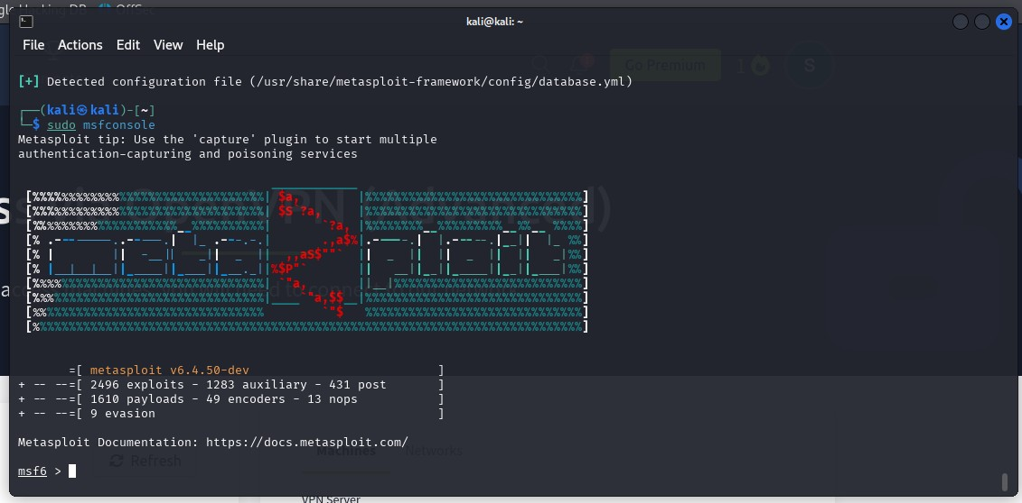
Command for changing prompt to msf6

Slide 23
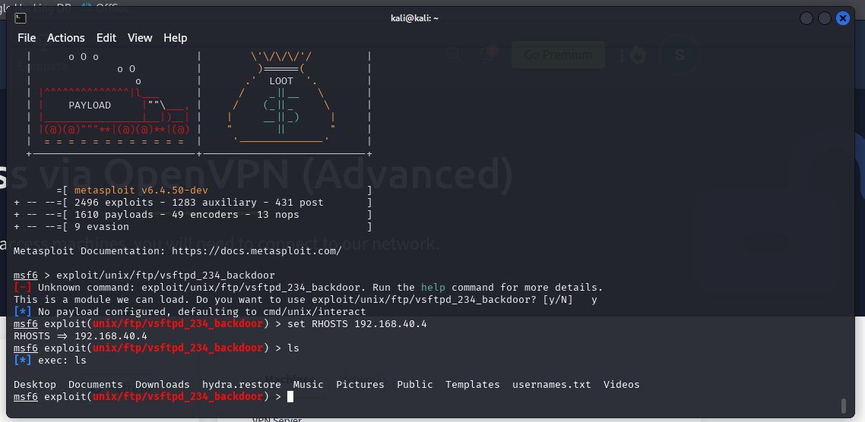
Screenshot exploiting vulnerabilities on port 21

Slide 24
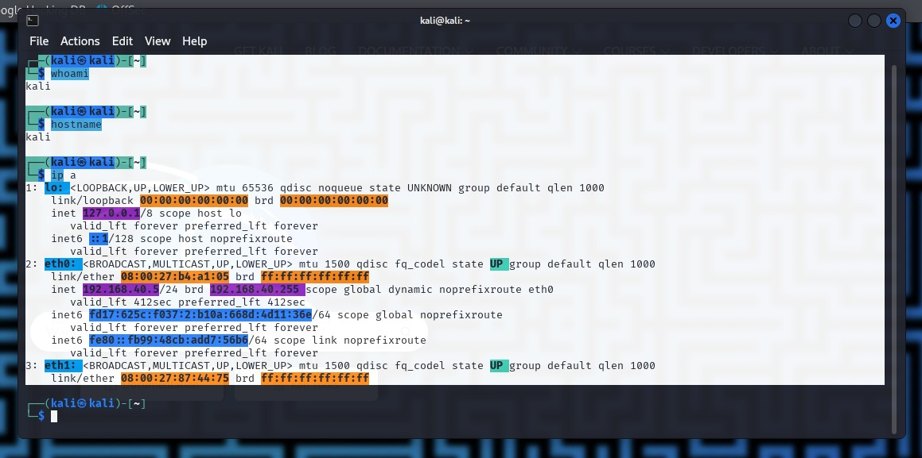
Gathering basic system info to prove system access using Whoami command.

Slide 25
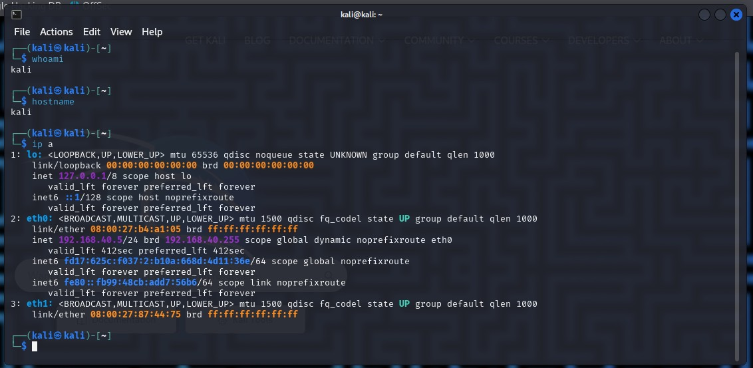
Gathering basic system info to prove system access using Whoami, hostname and ip a commands.

Slide 26
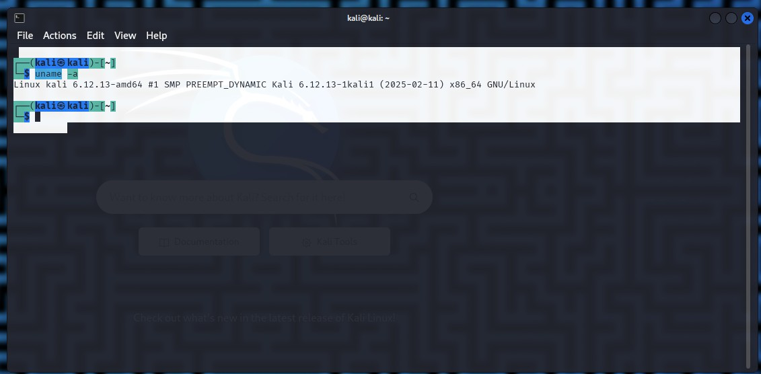
Running exploit command uname -a

Slide 27
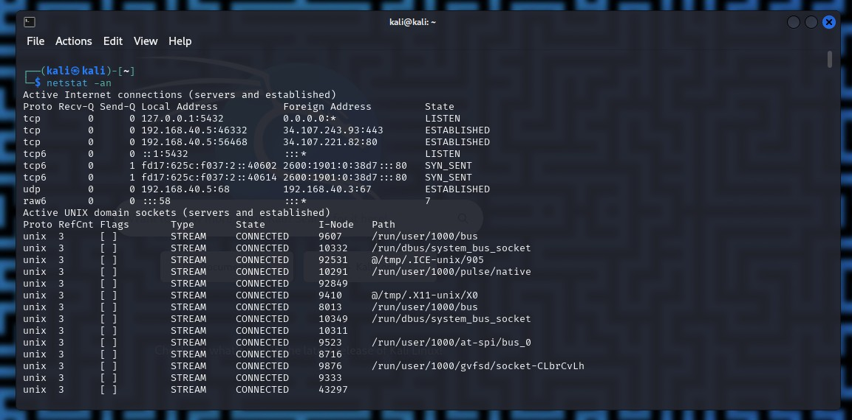
Running command netstat –an showing connection

Slide 28
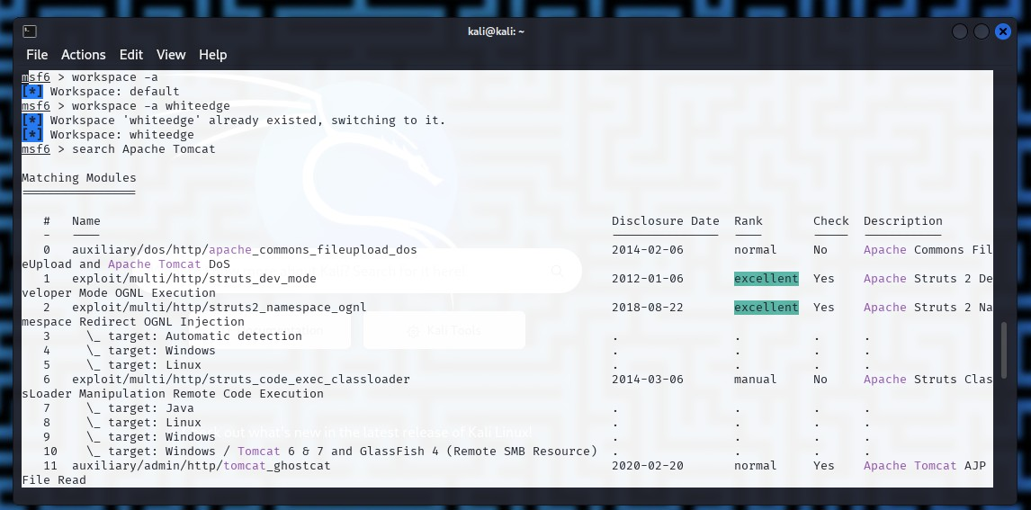
Running command search Apache Tomcat to exploit port

Slide 29
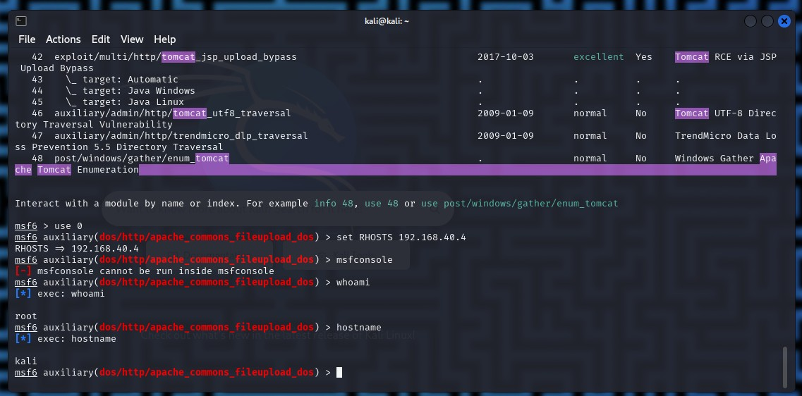
Screenshot showing exploit has been set; From this point it is possible to exploit the system through downloading or viewing confidential files or even upload a virus.

Slide 30
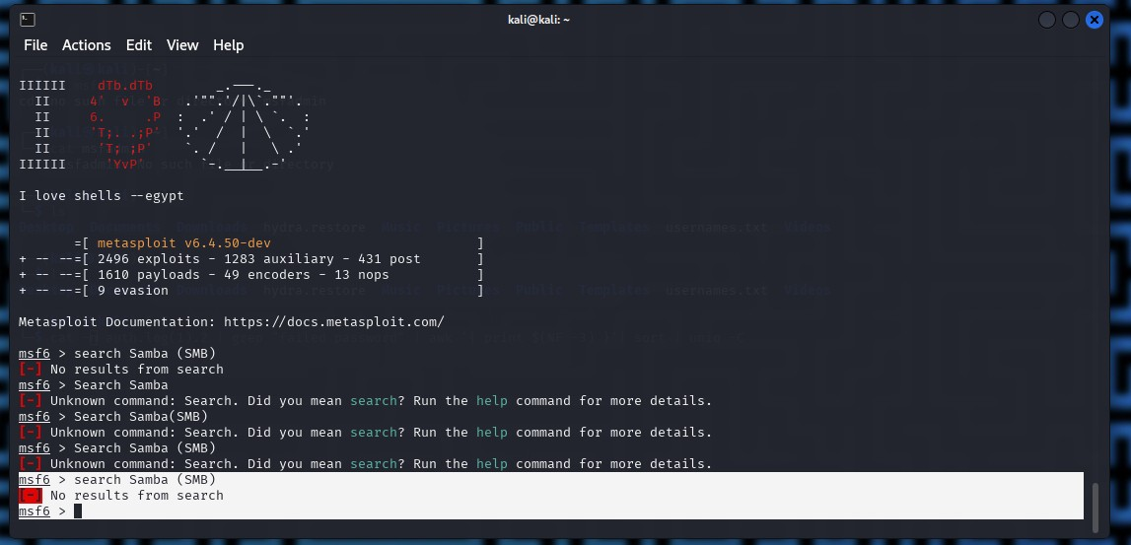
Using command Search Samba to exploit vulnerability on port 139 showing no result

Slide 31
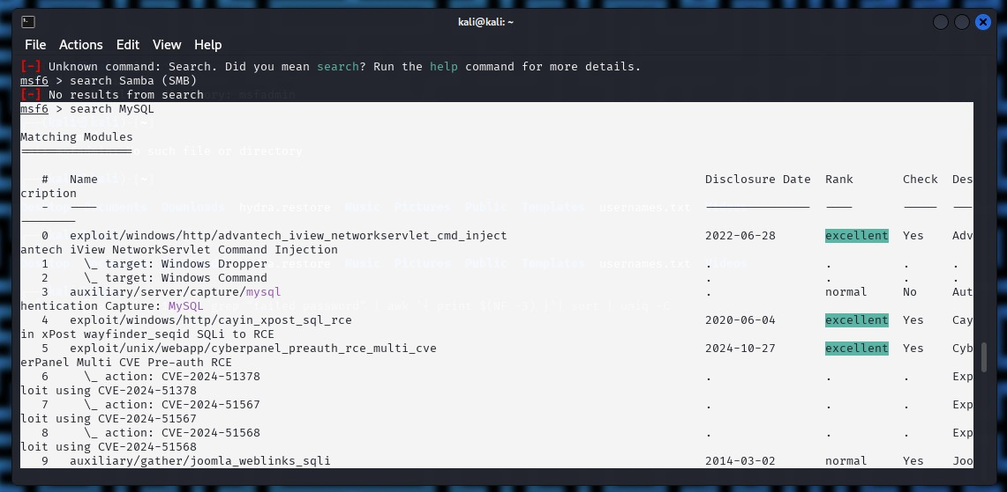
Using command Search MySQL to exploit vulnerability on port 3306 showing result

Slide 32
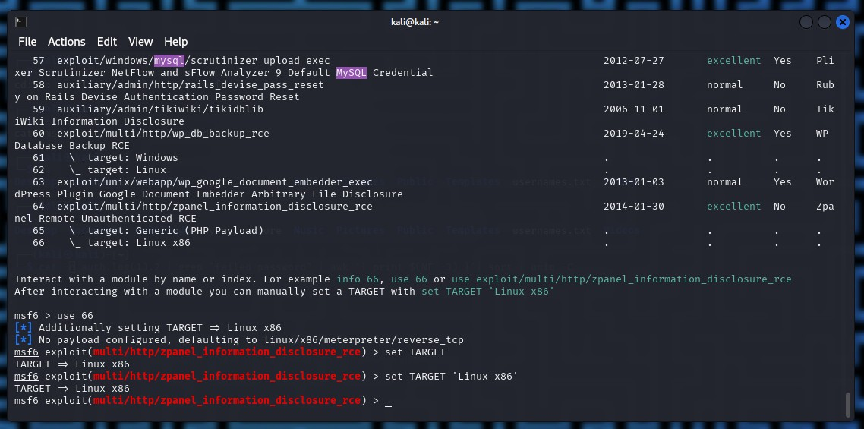
Screenshot showing exploit on port 3306; MySQL

Slide 33
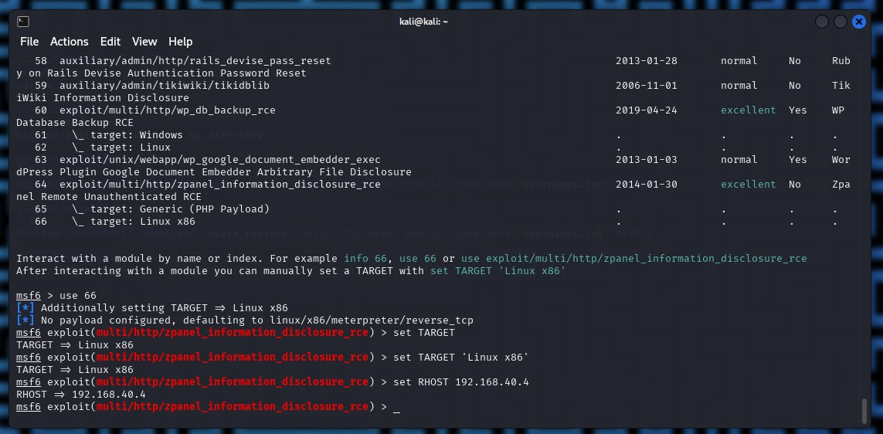
Running exploit command

Slide 34
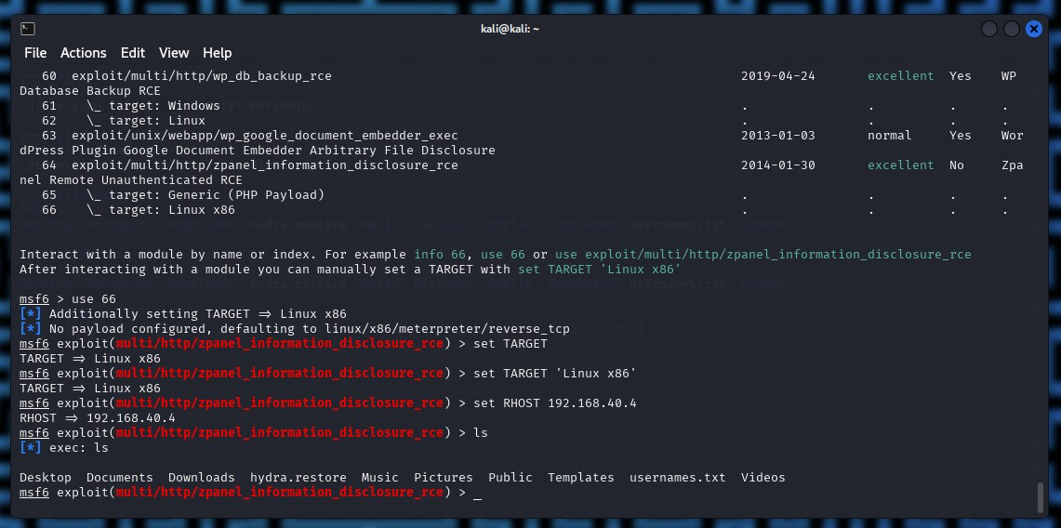
Access has been granted to the system

Slide 35
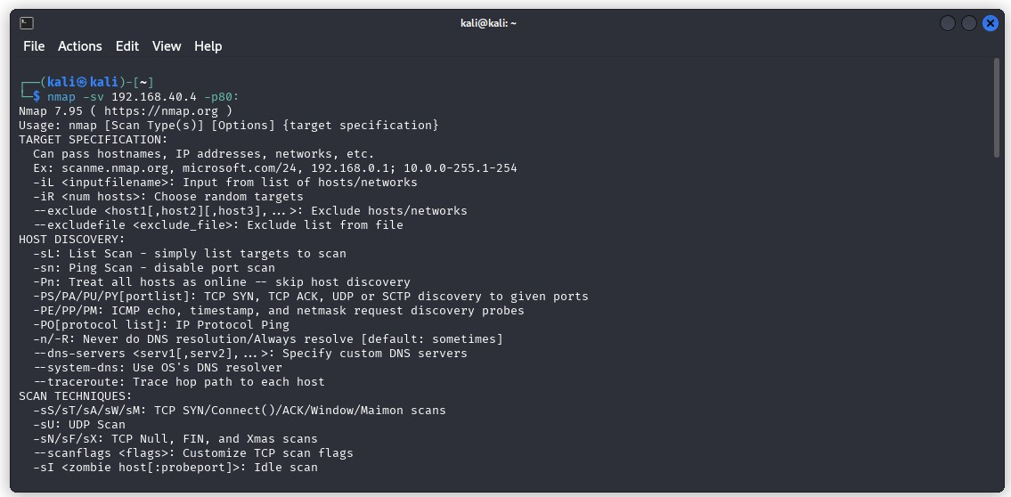
Phase 4: Post Exploitation: Gathering basic system info and prove system access. Running nmap scan to search for vulnerability on port 80

Slide 36
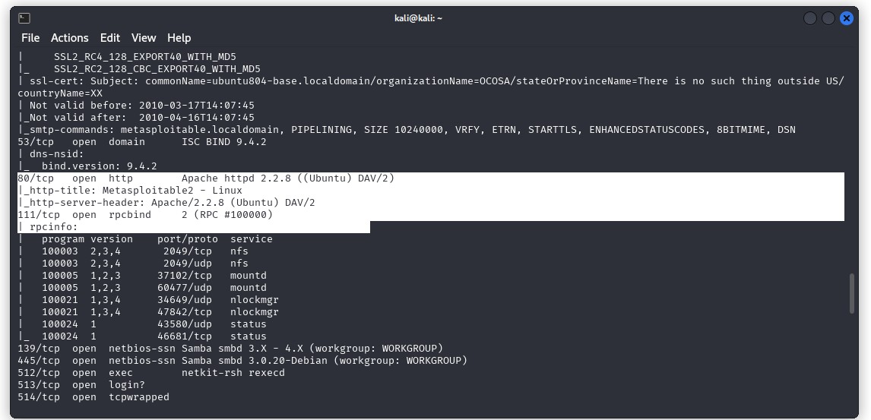
Port 80 scanned and discovered to be open

Slide 37
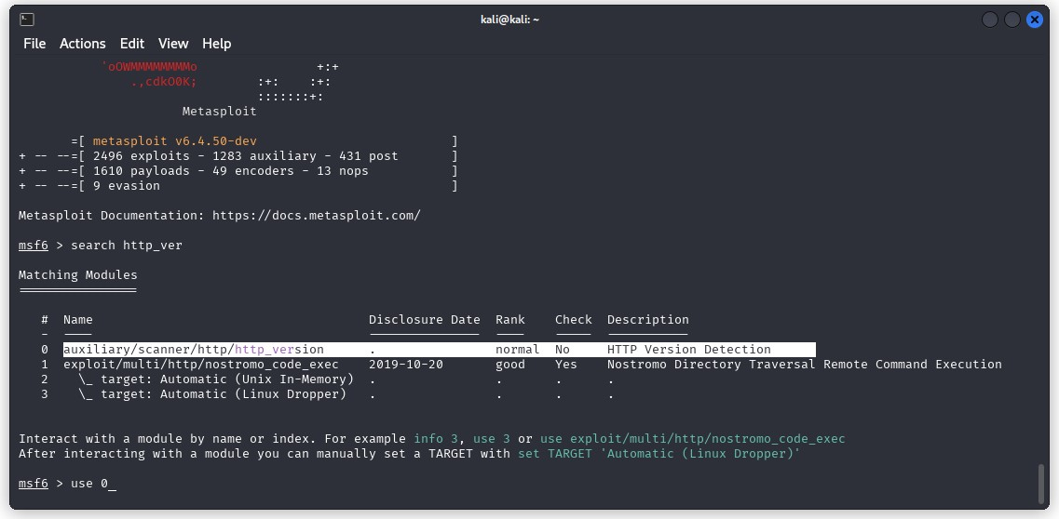
Use 0 to exploit

Slide 38
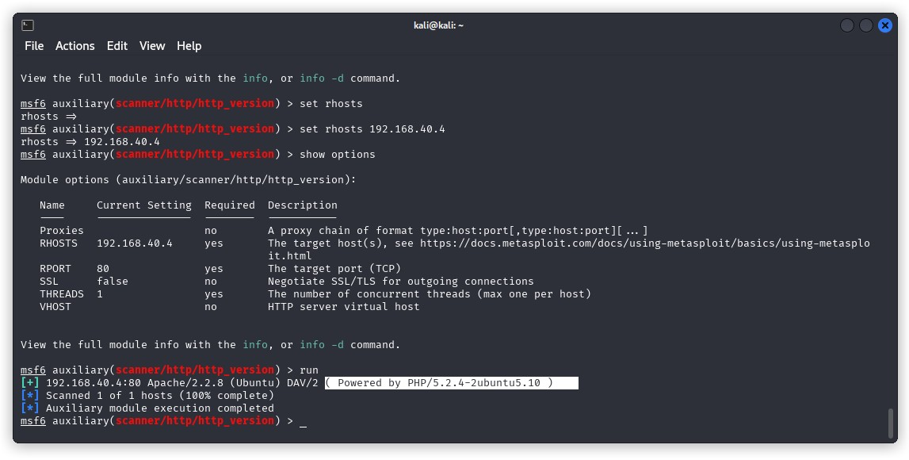
Showing what PHP is running

Slide 39
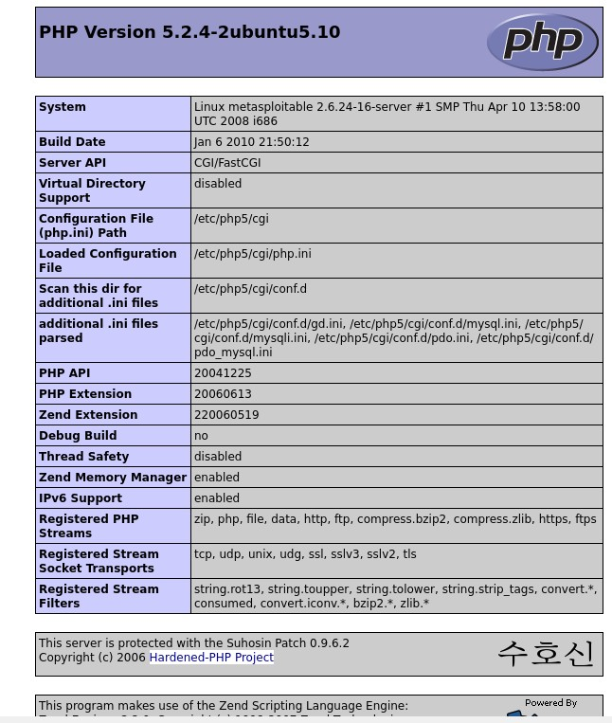
Screenshot showing Ubuntu version

Slide 40
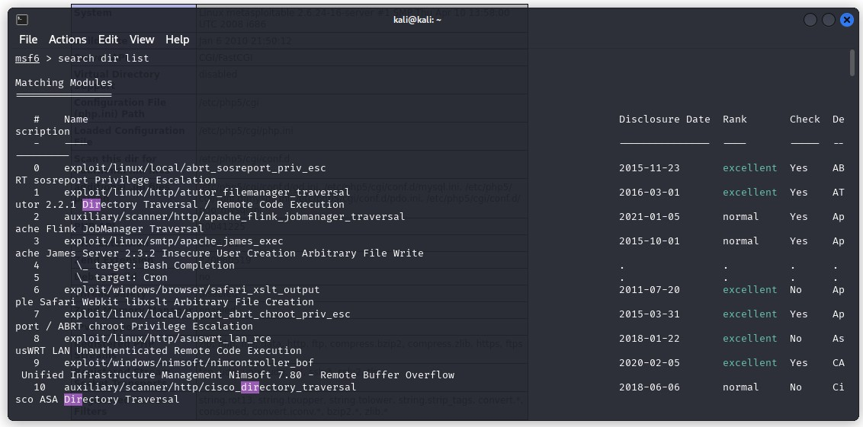
Info on search dir list is displayed

Slide 41
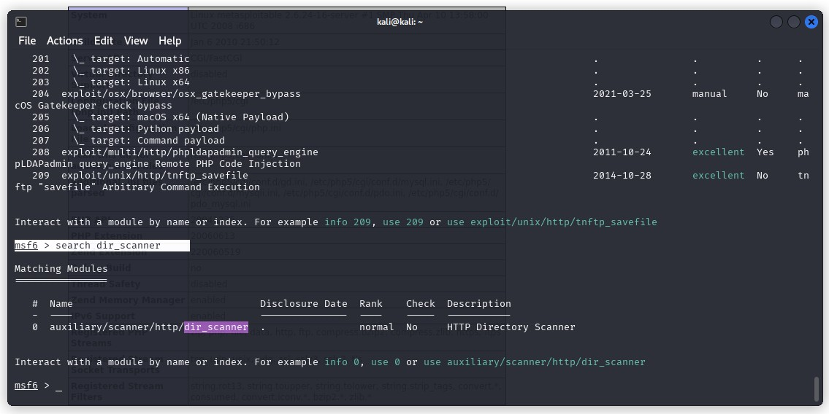
Run command search dir_scanner to find HTTP vulnerability

Slide 42
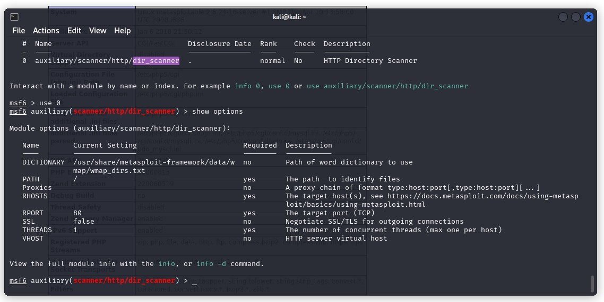
Screenshots of using 0 and show options

Slide 43
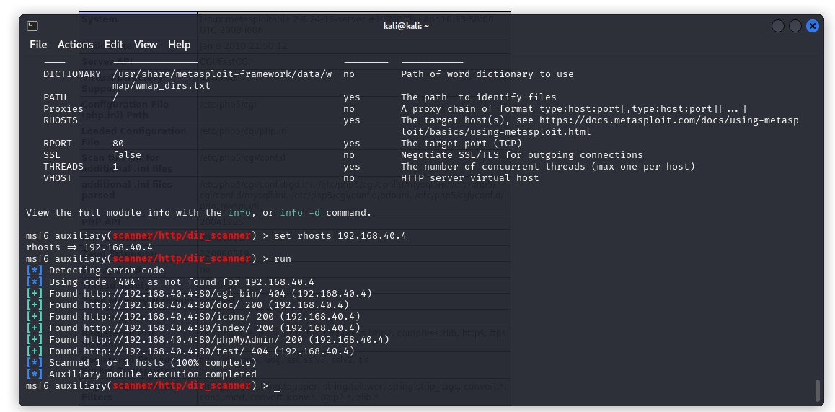
Using rhosts 192.168.40.4

Slide 44
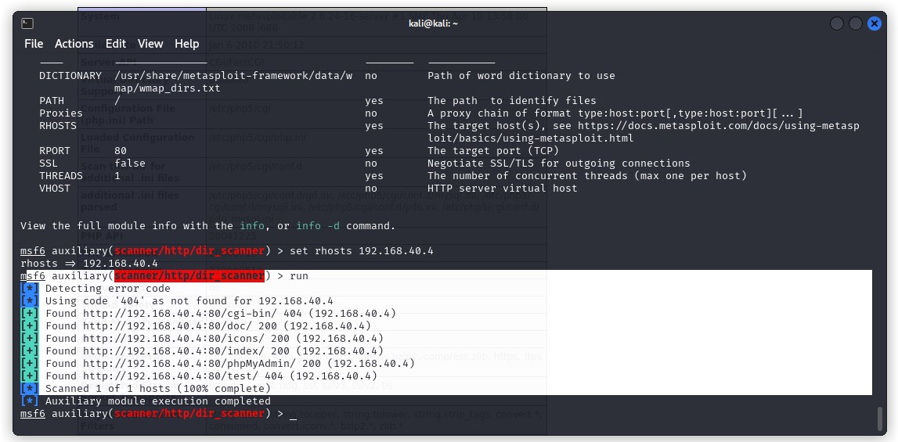
Using rhosts 192.168.40.4 shows the error codes detected

Slide 45
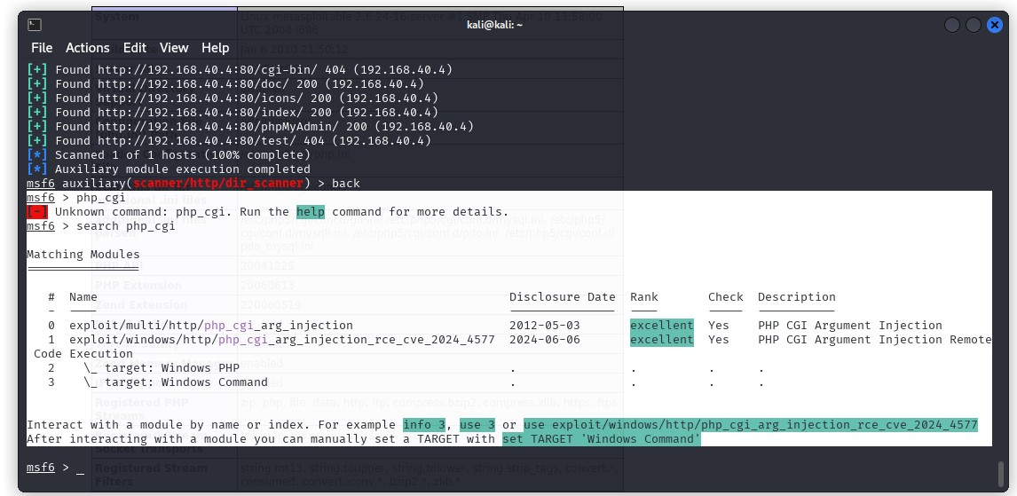
Exploitation using the command search php_cgi

Slide 46
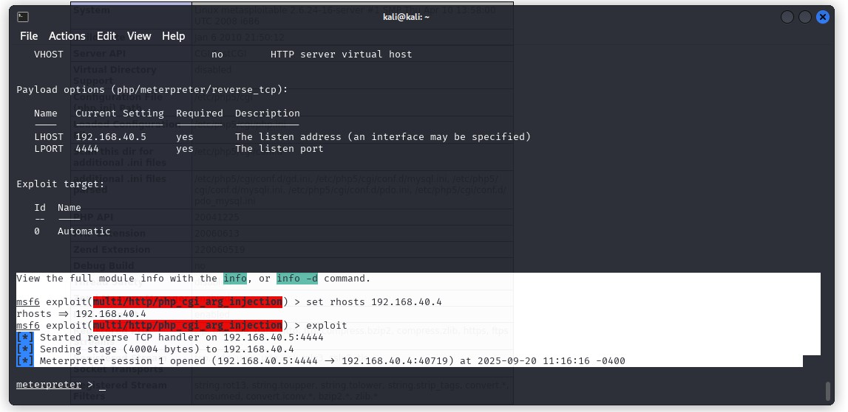
Exploit in progress by using an Argument injection

Slide 47
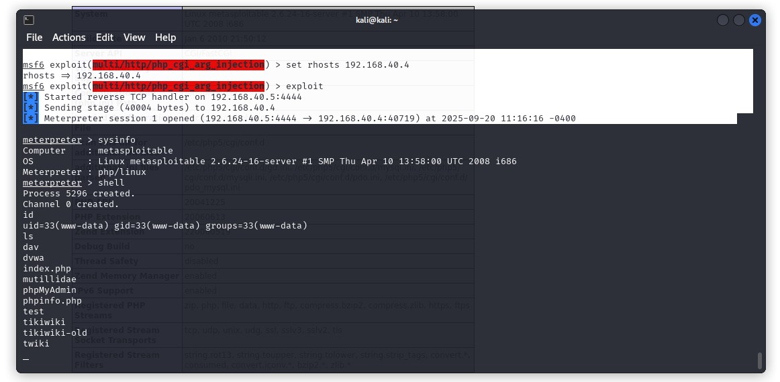
Screenshot showing port 80 exploitation

Slide 48
Phase 5 - Technical report: Testing Summary, Recommendations and conclusion
Testing Summary
The penetration test assessed Nova Ltds network and information security effectiveness. From an internal perspective, the Alfa tech team performed vulnerability scanning against all IPs provided by Nova Ltd to assess the resilience of the network. The team also performed common Active Directory based attacks, such as Argument injections to compromise the vulnerable ports, Beyond vulnerability scanning and Active Directory attacks, the Alfa tech evaluated other potential risks, such as default credentials on end point devices, and encryption system to gain a complete picture of the network’s security posture.
Vulnerability scanning by the Alfa Tech team discovered that ports HTTP, FTP, MySQL, the NetBIOS, Telnet Session service among others were open and unsecure in the network, which leaves the network susceptible to a variety of attacks which include but not limited to Ransome ware, Chryptomalware, SQL injections, Man in the Middle attacks (MITM), cross site scripting (XSS), DNS poisoning, MAC spoofing and DDOS attacks.
The majority of findings was related to patch management vulnerability as the end point device showed critical out-of-date software (PHP version 5.2.4 – 2 ubuntu 5.10) to be present within the network.

Slide 49
Recommendations
Testing results of the Nova Ltd network penetration tests are indicative of an organization with an ineffective patching and insecure ports policy. This lack of an open or insecure ports policy led to the vulnerability of the network and is usually one of the first footholds a threat actor can exploit in a network. The presence of insecure ports policy is proven by the evidence of our testing team accessing the network through over 5 insecure ports through various exploit commands.
Additionally, Alfa tech recommends that Nova Ltd explores the use of open source intelligence to effectively identify and blacklist unusual IP addresses attempting to access its network at unofficial hours and from foreign countries. furthermore, mandatory Access control should be implemented to ensure the proper classification of data according to level of sensitivity which will ensure proper application of principle of least privilege.
We also recommended that Nova Ltd
Revamp their current Firewalls rules and implement a next generation firewall system to mitigate the risks of insecure networks by filtering network traffic through application level inspection, IPS, and SSL inspection.
Utilise endpoint detection and response systems to mitigate Ransom ware and cryptomalware attacks while utilising a full backup system for a Hot site in a remote location.

Slide 50
Recommendations
Installation of Intrusion Prevention or detection system to identify and prevent dangerous or unusual network traffic in the network
Switch from digital encryption system (DES) to advanced encryption system (ADS) to ensure confidentiality of files as a result of unauthorised access.
Installation of a honey pots to identify and study unusual network and system for effective mitigation and incident response planning.
The use of Digital signatures and hashes to ensure integrity and nonrepudiation of data in transit.
Lastly, since weak patching and outdated operating systems can potentially lead to the compromise of the IP address within the network, we recommend that the Nova Ltd team review implement policies and controls in accordance with the Nova Ltds risk management framework for continuous monitoring to ensure that risks are effectively identified and adequate controls are in place.

Slide 51
Conclusion
Considering the prevalence of a weak patching policy and an outdated operating system which can potentially lead to the compromise of IP addresses within the network, the Nova Ltd team must review and implement policies and controls in accordance with ISO 27001 Information Security Management System (ISMS) risk management framework and apply for certification to ensure continuous improvement, this will ensure that vulnerabilities and threats are adequately identified and effective controls are implemented and monitored on a continuous basis to achieve confidentiality, integrity, Availability, security and privacy of organisational and customer Data.
This will give all relevant stakeholders reasonable assurance that material risks are identified, analysed, assessed, prioritised and treated in accordance with Nova Ltd risk appetite and further ensure that effective controls are implemented to ensure achievement of the business organic and inorganic objectives.

Slide 52


